Slide 1


IST 615 Final Project |Spring 2021

Slide 2
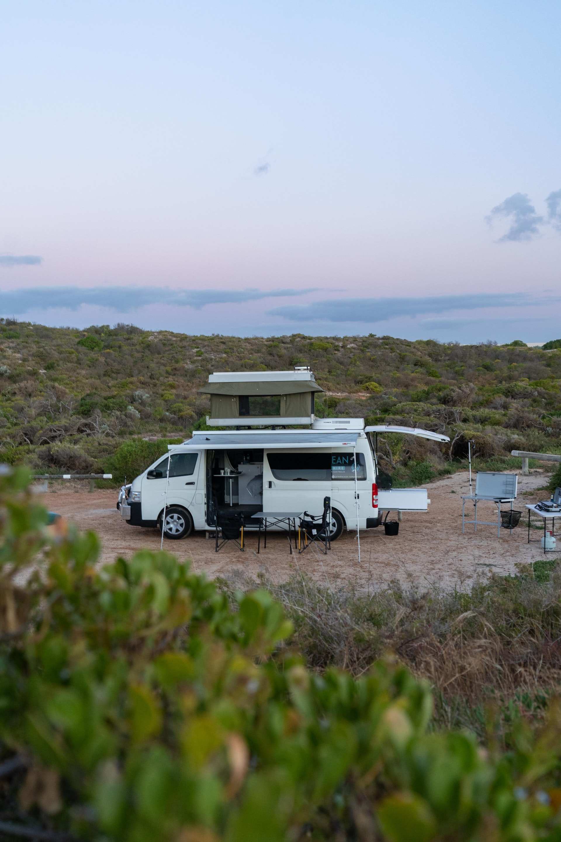
YOUR PERFECT SPOT IS OUT THERE
Seed Funding Round and Planned Activities:
Rvacancy.info is a wanderlust-informed SaaS that connects roaming travelers with there perfect RV park location.
The application was built from the ground up by those inspired to roam freely to every corner of the country.

Slide 3

Problem facing RV-loving travelers.
Lost time searching online for desirable parks.
Outdated information about park and rest locations on web sites.
Inability to create a concise and comprehensive travel itinerary.

Slide 4
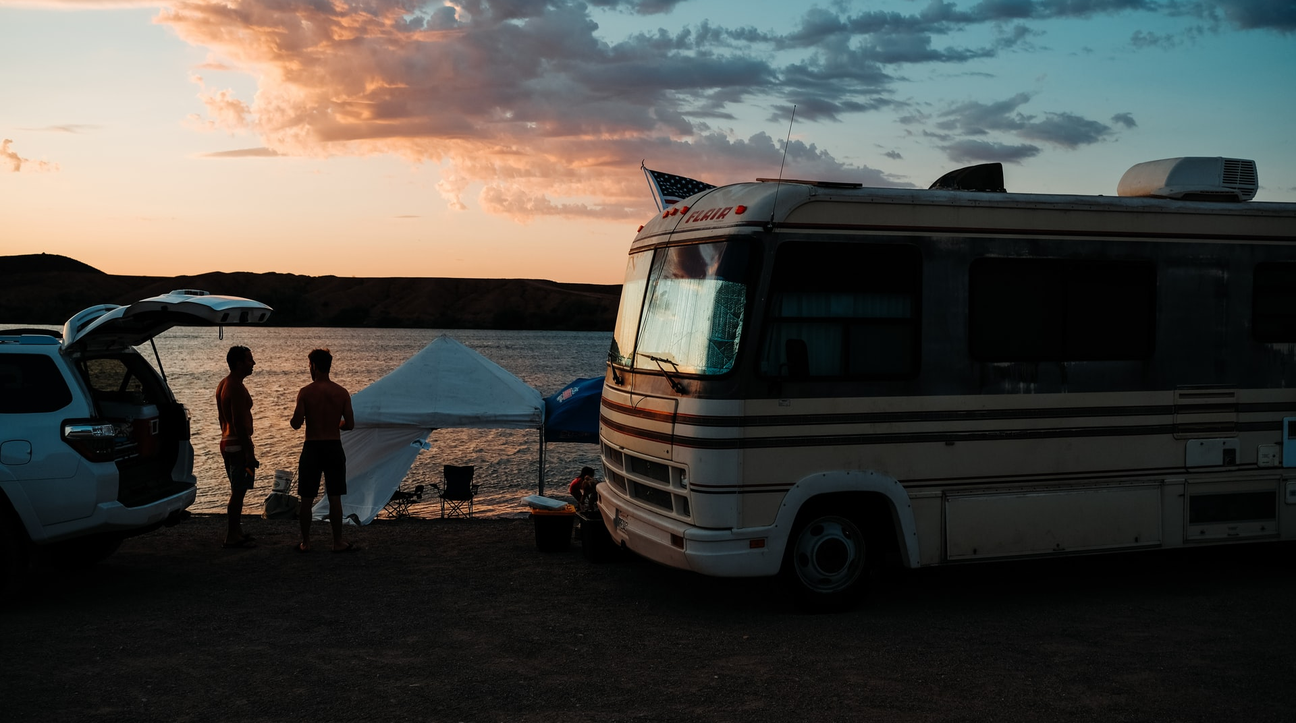
Solution for the RV-inspired lifestyle.

Slide 5


The RV Cloud Data Platform
Proprietary data mining activities to collect, classify, and map RV destination information and park attributes.
1
Public access geographic data lookup app to create travel itineraries of qualified RV-friendly locations.
2
Data analytics and machine learning algorithms to ensure the perfect destinations.
3

Slide 7
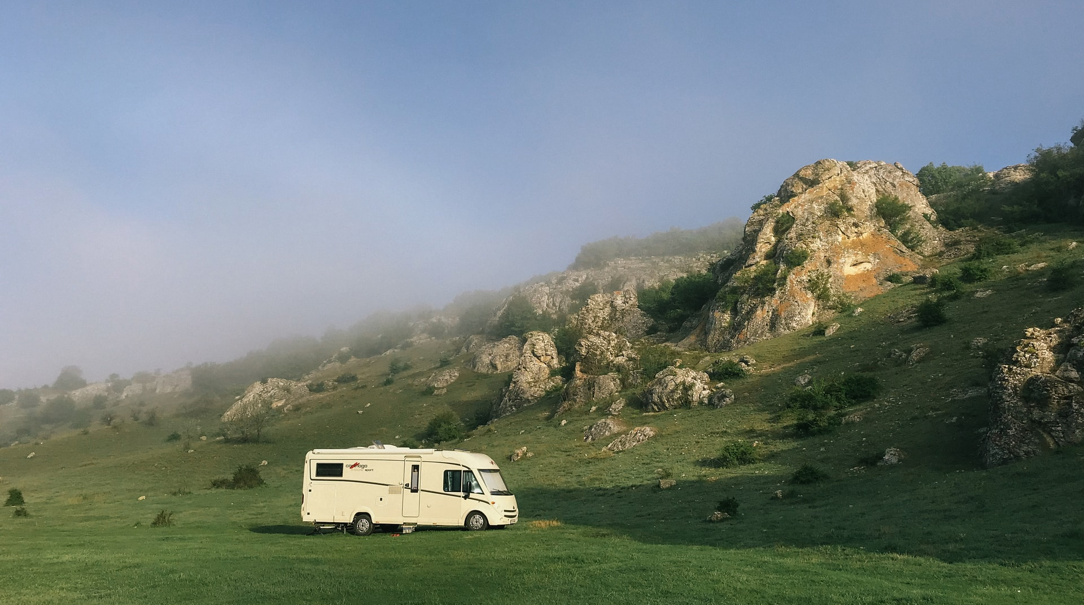
RVacancy Cloud
Technology and
Architecture

Slide 8
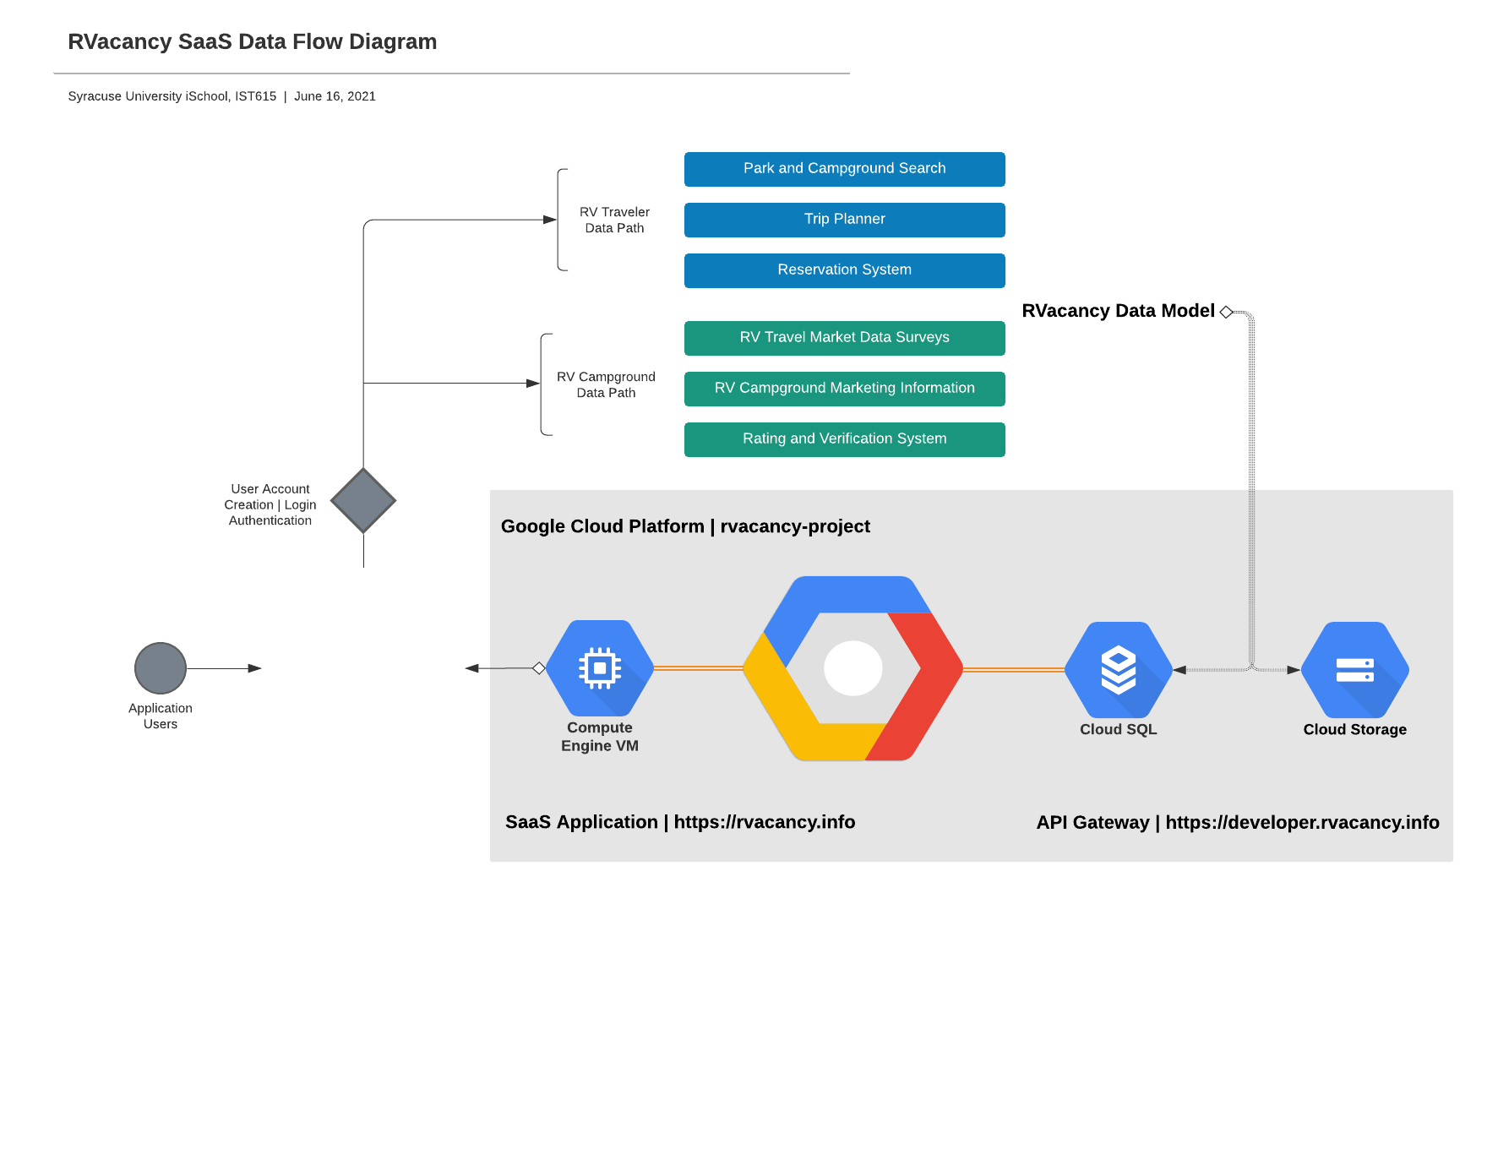
Notes:
Compute engine publishes the website
Website collects the data from uploads, submissions, RV owner or campgrounds
Data gets pushed
Site would be designed based upon visibility rules (traveler or park owner)
Bucket captures information from the website that is not caught by the SQL database (images, etc.)
API allows you to push data either from the bucket or from the database
Speak to data collected

Slide 9
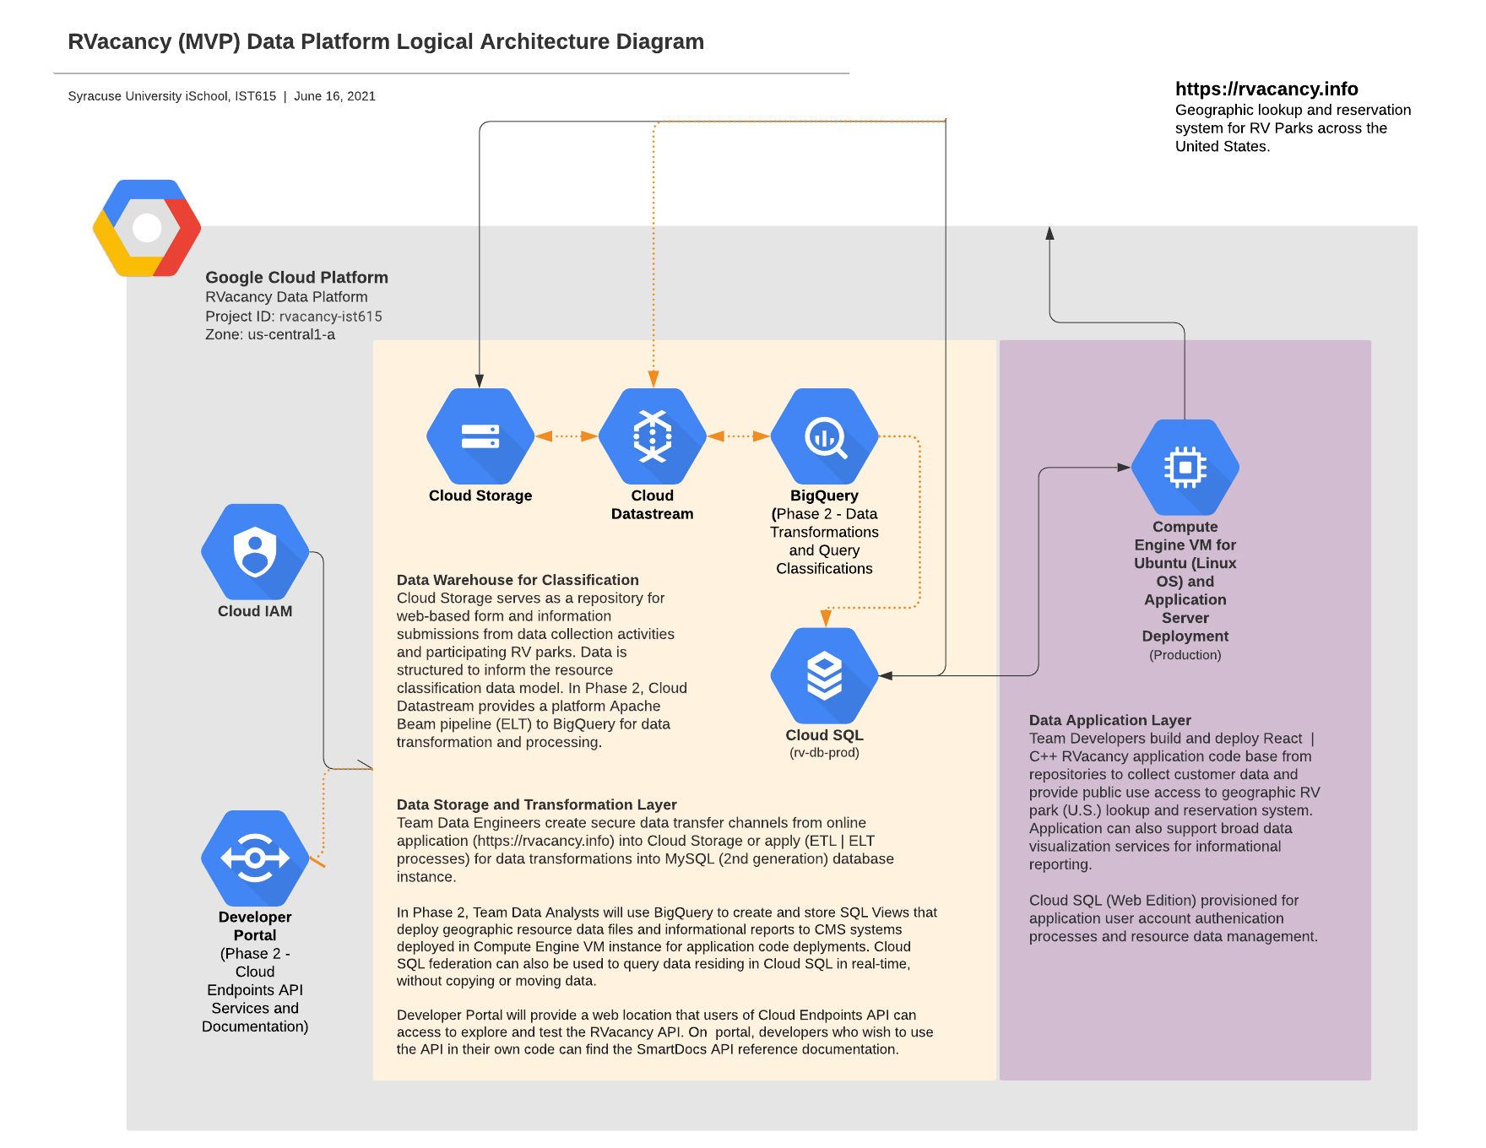

Slide 10
Competitor
Landscape

Slide 11

Collections of apps needed to cover all RV needs.
Competitor apps consist of route planners, maintenance schedulers & links to external sites for bookings.
No unified itinerary system across all parks and campsites that connects users in real time and offers a compete service.
Route planner apps use consumer subscription model which keeps best features behind a paywall.
Missed opportunity for data capture and analysis.

Slide 12
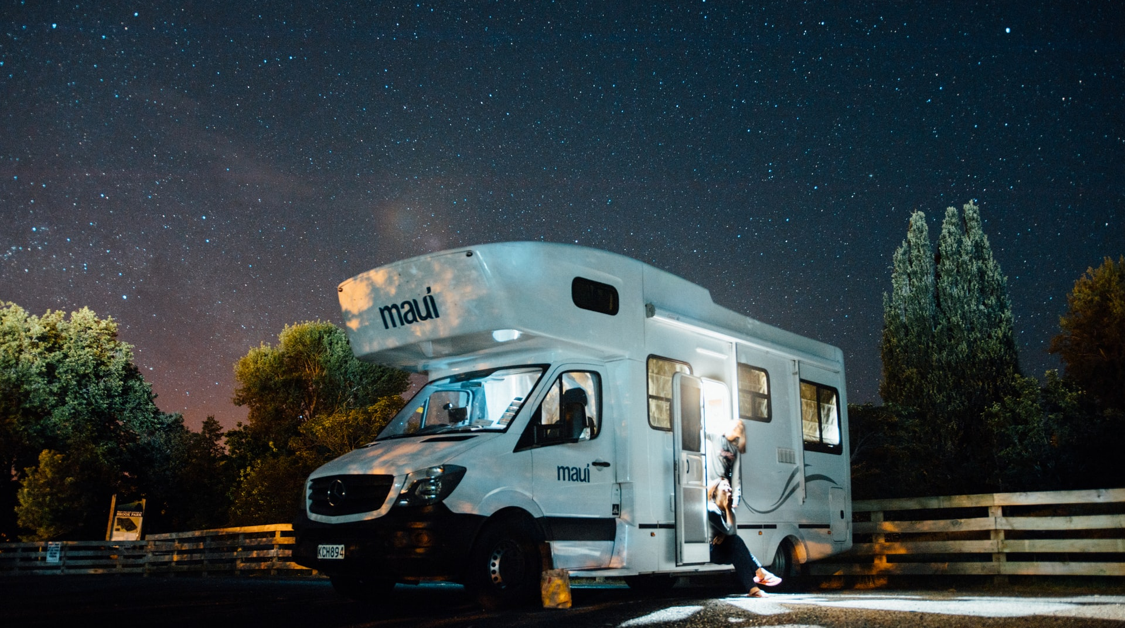
Market
Potential

Slide 13
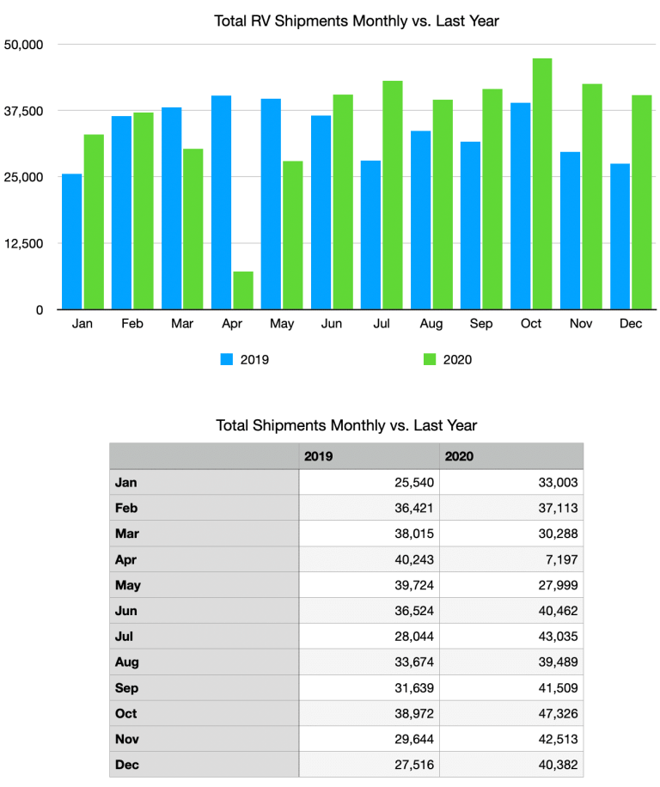
Market Potential
RV industry has tripled in size since 2009
Over 16,000 campgrounds and parking facilities.
North American RV market was valued at 26.7 billion in 2020 and expected to reach 35.7 billion by 2026.

Slide 14
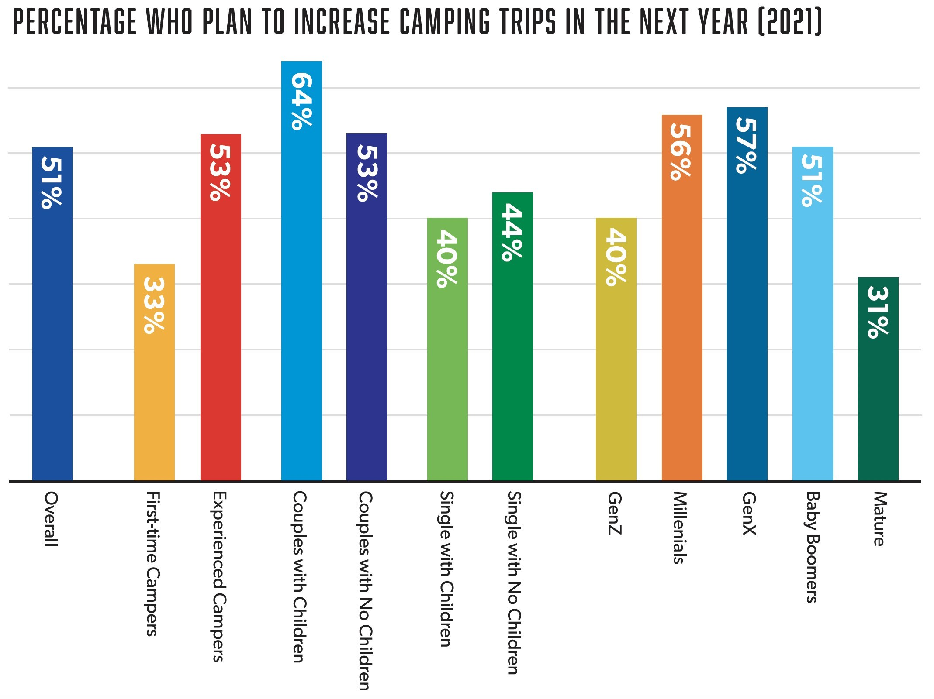
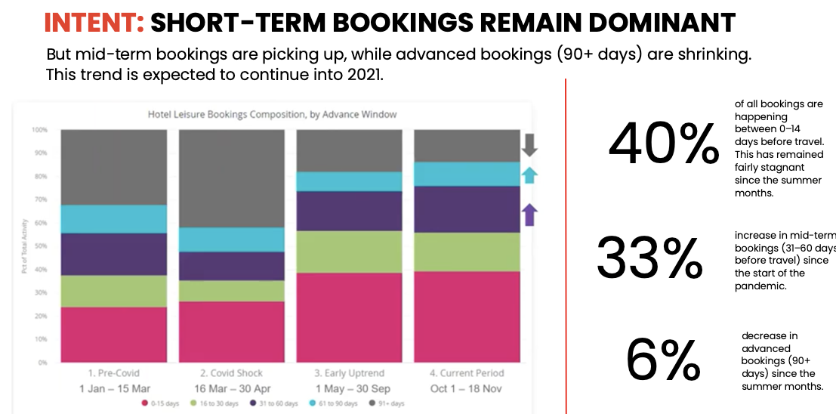
Recreational Vehicle Travel Trends
Over 46,000,000 Americans plan to go RVing in 2021
Almost 80% of bookings made by first timers
40% of survey respondents say they are unlikely to fly in 2021
68% of millennials said COVID-19 led them to find RVing more appealing
RVers spend between 3 – 4 weeks in their recreational vehicle per year

Slide 15

Target Markets and Travelers
(Yep, this guy.)

Slide 16
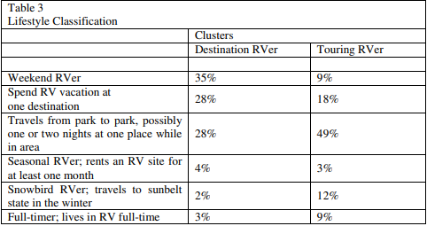
RV demographics are shifting from Baby Boomers to younger audiences, primarily between the ages 35-54
73% of millennials said they were likely to take an RV trip this year.
70% of those surveyed said minimal interaction with other travelers was important.

Slide 17
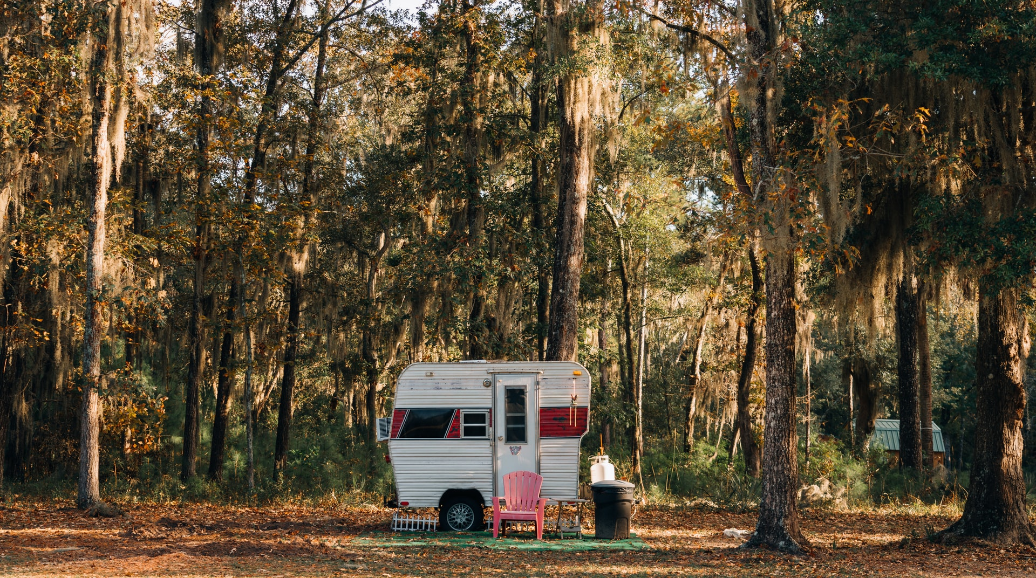
Market Approach
(Size doesn’t matter.)

Slide 18
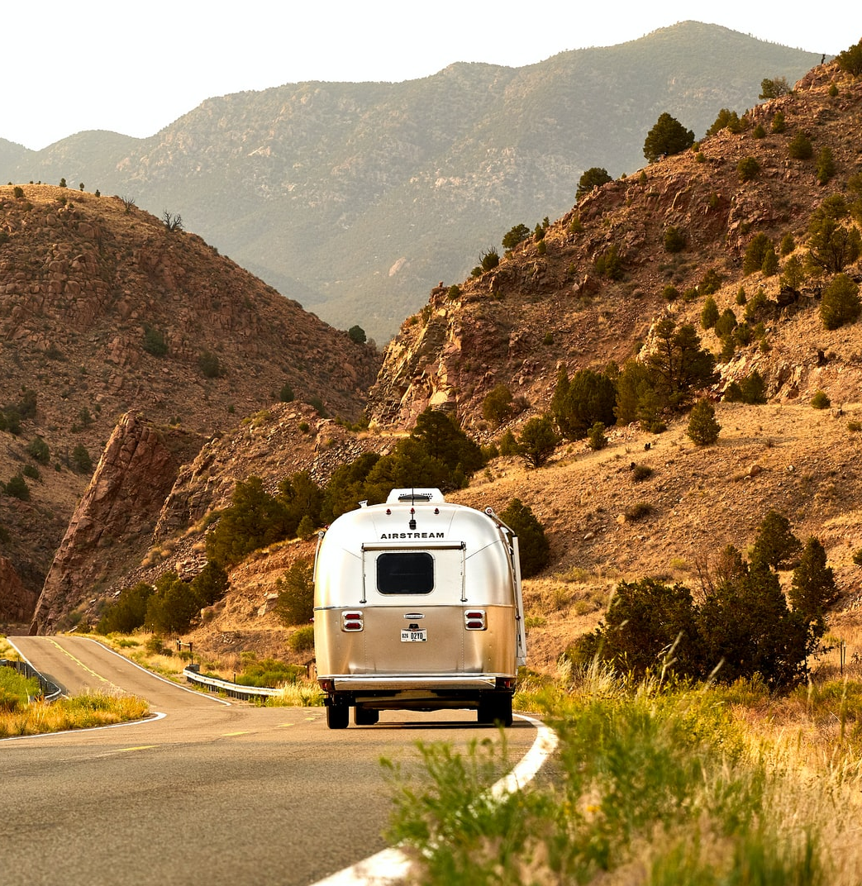
Online website running on Google Cloud
Capture, storage, and analytics on user and market data
Easy-to-use UI for campground availability, amenities, and campground websites
Ecosystem of integrated services
Connectivity
Business valuation of $10M

Slide 19
Financial Snapshot
Google Cloud Platform
Proforma Costs

Slide 20
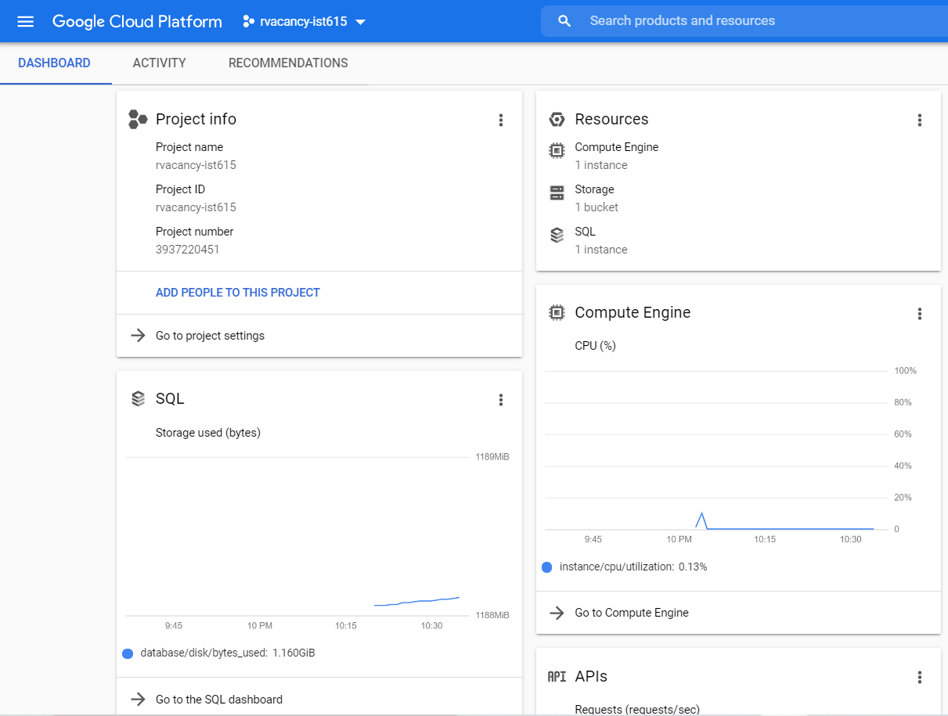
Google Cloud Console rvacancy-ist615

Slide 21
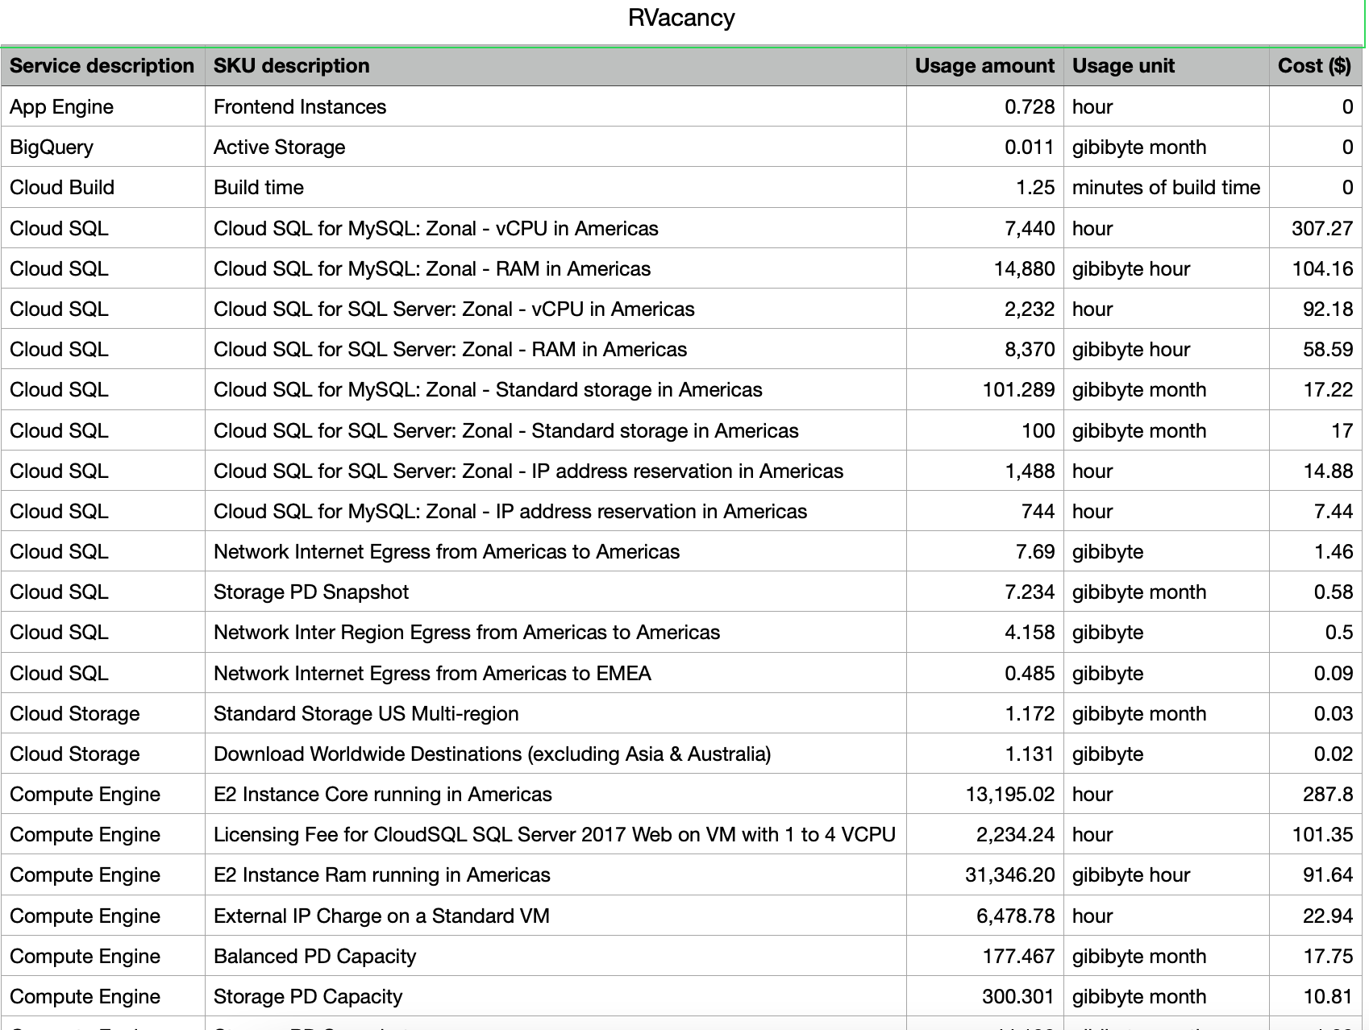
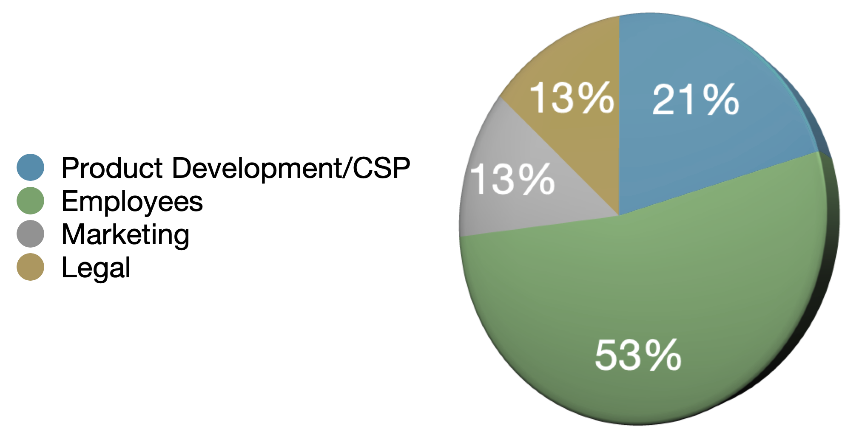
Initial Seed Raise: $1.5M
Annual Revenue Projection: $400,000
Annual CSP Cost: $14,691
Payback Period: 3.75 Years
Months to Market: 18 months
Cost Breakdown

Slide 22
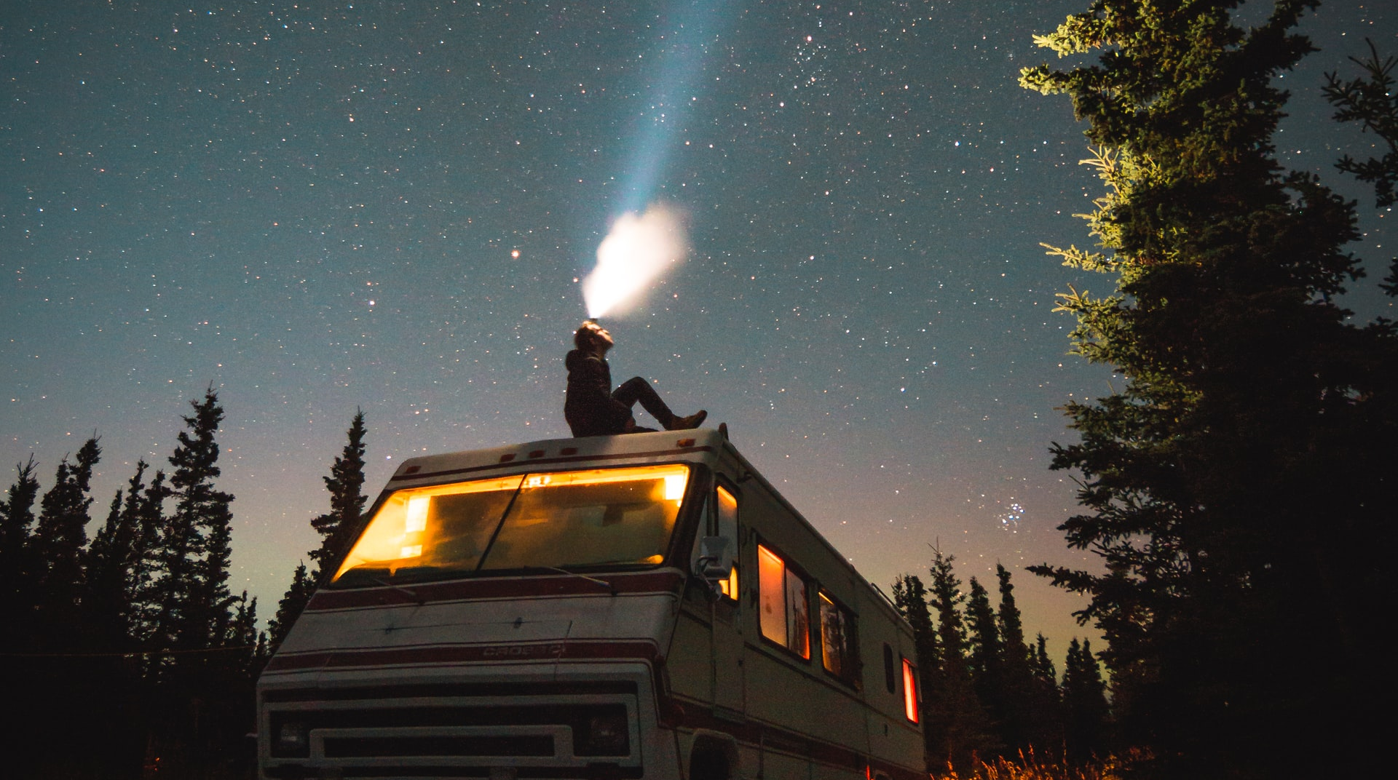
Life is a mystery.
Finding tonight’s resting spot shouldn’t be.

